Slide 1



Slide 2
Governor’s Workforce Development Task Force
Charge from Governor Otter
“Examine ways to improve Idaho’s funding and delivery of training programs to meet our state’s growing demand for skilled workers.”
Review current delivery system
Look at best practices
Recommend what is likely to work in Idaho

Slide 3
Governor’s Workforce Development Task Force
State & Federal Investment in
Workforce Development Programs
24 Programs
8 Agencies
Over $161 million

Slide 4
Increase public awareness of and access to career education and training opportunities.
Improve the effectiveness, quality, and coordination of programs and services designed to maintain a highly skilled workforce.
Provide for the most efficient use of federal, state, and local workforce development resources.

Slide 5
Idaho Workforce Development Council
17 representing industry
7 representing the workforce
  2 labor union
  2 registered apprenticeship
  1 community-based organization for veterans
  1 community-based organization for people with disabilities
  1 community-based organization for out-of-school youth
9 representing local government including:
  elected city official
  elected county official
  community college representative
2 legislators, one from each chamber
The Governor or his designee

Slide 6
Workforce Development Training Fund Programs
Employer Grant: Awarded to a company to reimburse workforce development training costs.
Industry Sector Grants: Granted to a consortium who has identified a training solution to alleviate an industry specific skill gaps.
Innovation Grants: Designed to fund projects serving youth or adults and benefiting localized and/or rural efforts.
The council also strategically sponsors Outreach Projects that provide public information and outreach on career education and workforce training opportunities, including existing education and training programs and services not funded by the training fund.

Slide 7
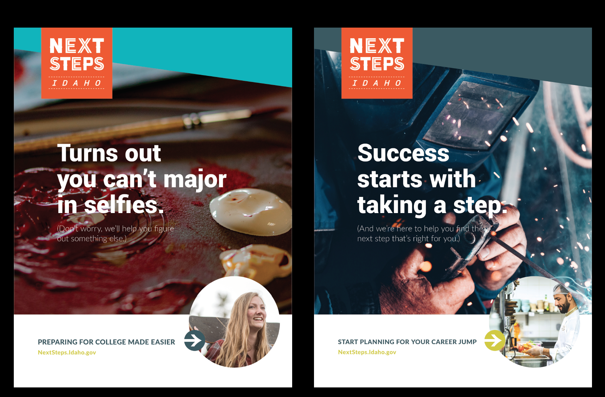
Notes:
The Next Steps (OSBE) website came into focus as a possible launch point, due to its widespread adoption amongst key audiences (8th – 12th grade students, educators, and parents), the possibility for broad application of the brand and its messages, and a similar content emphasis.
Together, WDC and OSBE have embarked on a six‐month project to research how the Next Steps brand might be expanded to appeal to a broader audience (younger students, adults at various points in their careers, employers).
Throughout, we have engaged WDC’s Outreach Committee (includes industry leaders), the Idaho Department of Labor, Idaho Department of Education, Career Technical Education, and college and career counselors.

Slide 8
